Slide 1
TEST AUTOMATION AND DIGITAL QA SUMMIT #TAS21
USA Season 6
October 28, 2021

Slide 2
Test Automation Maturity:
Systematically increasing the value of your testing tools
Notes:
Test Automation Maturity: systemizing increased value into our testring tools.
Hello everyone. i am very honoured you are sharing your valuable time to watch my presentation.
Everyone here should be very proud that you are so dedicated to improving your QA craft.
We probably have lots of badass test automation developers here. I’m a badass automation developer.

Slide 3
About me
Test automation & software QA since 2000
C, Visual Basic, PHP, C#, Java, Python
Over a dozen testing tools and frameworks
Notes:
A quick intro: I started working in QA 21 years ago
I’ve built lots of tools and frameworks. I started with “C” language, and after blaming my memory allocation bugs on the other guy’s code, i’ve progressed through several other languages.
My first manager convinced me to join his QA team by promising I could be a “cowboy programmer”. I was so young that I thought “cowboy programming” was a good thing. Now, of course, I have turned to the good side and fight cowboy programming wherever it strikes.

Slide 4
Agenda
A frequent challenge for QA teams
My approach for improvement
My “Test automation maturity” scales
Walkthrough of repeatability demo project
Notes:
What am I showing you today?
I’ll describe a challenge I’ve faced many times, and I expect you have also.
We’ll look at how I tackle that challenge by maturing my tools.
You’ll see the scales I use to measure the maturity of my software tools.
And finally I’ll walk through a demo of a maturity scale in practice.

Slide 5
Potential takeaways
Optimism! Your challenges are shared
Concrete automation techniques
Commitment to methodical improvement
Inspiration to reframe your team’s mission
Notes:
What do I hope you’ll get from this? First, optimism. You can feel ok knowing that your problems are not unique, and they’re not unsolvable.
You’ll see a few concrete ideas you may want to steal, er, borrow for your own automation
But more importantly, I hope you’ll leave with a commitment to -methodically- improve your test tooling
And if I’m really lucky, you’ll actually be inspired to reframe your team’s mission to make it more effective.
Let’s get started!

Slide 6

New automation - Things are great~!
Super fun writing new code!
Lots of useful tests!
1 button for nearly instant results!
We are flying fast!
Notes:
What happens we build a new automation probject? Everything is awesome!
We’re having lots of fun writing our COOL new code
Every week we’ve adding a dozen new tests.
And everyone is impressed that we push a single button and get lots of useful test results.
We are flying so fast! YAAA BABY

Slide 7
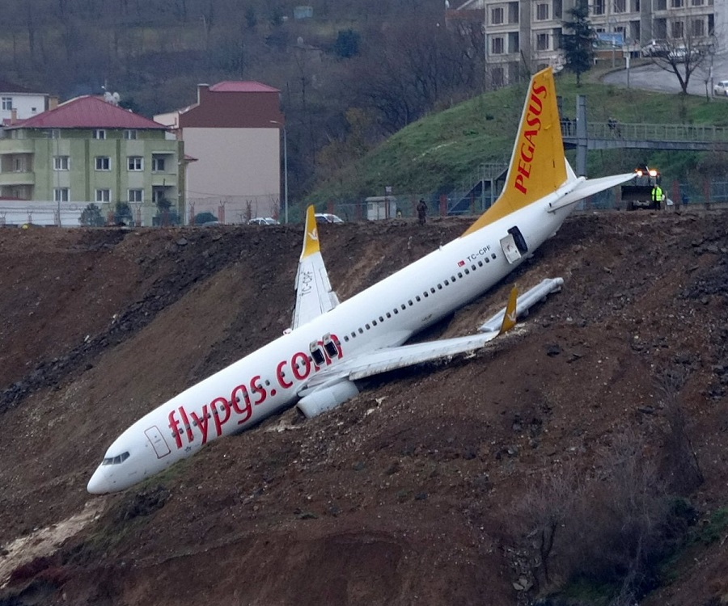
Old automation - Not so great...
Always re-starting new test runs
Confusion when & where to test
Small changes break randomly
Manual testing of failed tests
We are stuck in the mud!
Notes:
But after a while, things slow down.
Our team might grow a little bit.
We’ve got more engineers telling us to start new tests more often
Tests start to break and are harder and harder to fix
we’re doing more and more manual tests again...
Eventually, we feel like we’re stuck in the mud.

Slide 8
Full Time Maintenance Mode
Eventually...
All effort seems sucked into just keeping up with the current release
Never any free time to make the automation faster or more reliable
What happened to the dream of hands-off testing?
Notes:
What’s going on?
All of our effort is sucked into just keeping up with weekly releases.
It’s like we’re on a treadmill, and can’t move forward any more.
Our dream of pushing a single button, leaning back, and letting our tools do all the work for us starts to look further and further away.

Slide 9
But why?
Building the tool is only the start, not the end.
Begin with nothing: 100% effort in building
More useful = More pressure to stop building & start using.
Short-term pressures for speed, distracts from long-term sustainability.
We become victims of our own success.
Notes:
But why?
At the beginning we get to put a hundred percent of our effort into growing our test automation.
But once that tool starts to work well, everyone thinks we’ve finished our work. They just want us to keep using that great tool more and more.
But they don’t realize that building the tool is just the START of our job, not the END.
We actually become victims of our own success: The better we make our tool, the less effort people think we should be putting into improving it.

Slide 10
How can we get our focus back?
Plan for a Mature QA Mindset.
“We run tests to analyze quality”
“Build testing tools for everyone to assure quality”
Notes:
How can we get our focus back on growing and maintaining our tools, so we don’t get stuck in the mud?
Usually it takes a new mindset, and it takes a plan.
We want to change our mindset from: “We sit in a cave running a bunch of tests to tell you the quality”
We want to change our mindset to: “We make awesome tools so everyone else can test their own quality”

Slide 11
Switching to a mature mindset
“We run tests”
Focus on Coverage
Manually re-run flaky tests
Only QA use automation
QA analyze & report results
“We provide tools”
Focus first on Reliability
Fix flaky tests, always.
Anyone can use automation
Results are published for all
Notes:
What does MY mature QA mindset look like?
My focus is on reliability first. My tools might give you less answers, but they will be reliable answers.
This is because I will not tolerate any flaky tests. A missing test is better than a test you cannot trust.
My tools are friendly. Anyone technical in my team can use my tools. -I- am no longer the test execution bottleneck.
The results are clear and they are easy to find. You do not need me to interpret them like a foreign language.

Slide 12
2 sides of an effective QA mindset
Planning Maturity
Understanding The Needs
Validating Requirements
Planning tests
Maintaining traceability from Requirements -> Code
Tooling Maturity
Making the tools
Architecting the framework
Writing the code
Making the tooling accessible
Notes:
There are 2 halves to reach this effective mindset
There’s improving your test planning. This ensures we really understand the product needs
There’s the tooling maturity. This is where we turn those needs into great tools to test those needs

Slide 13
Good planning is essential
“Garbage in, Garbage Out”
Planning Maturity
Understanding The Needs
Validating Requirements
Planning tests
Maintaining traceability from Requirements -> Code
Tooling Maturity
Making the tools
Architecting the framework
Writing the code
Making the tooling accessible
Notes:
In my opinion, Planning Maturity is the more important half.
If you get garbage in, you’ll get garbage out.
Bad planning can ruin the best tools…. but the best tools can NEVER fix bad planning.
Getting good at your planning maturity would be a whole other presentation. But to summarize: Good planning means you have validated your requirements, planned your tests, and are maintaining your traceability.

Slide 14
Tooling enables process improvement
Frictionless tools become useful tools
Planning Maturity
Understanding The Needs
Validating Requirements
Planning tests
Maintaining traceability from Requirements -> Code
Tooling Maturity
Making the tools
Architecting the framework
Writing the code
Making the tooling accessible
Notes:
Today we’re more interested in the fun stuff. Coding!
mature tooling involves the typical engineering principles:
designing a good framework
writing high quality code
and making your tool accessible to your teammates
I think one of the most powerful measurements of how useful your tool is, is how frictionless your tool is to everyone else.

Slide 15
Measuring tool maturity
2 scales:
Reliability:
Tool provides accurate test results, and those results are easy to find and interpret
2) Repeatability:
Tests are easy to trigger manually or automatically, and every run is performed identically.
Notes:
Let’s see how I measure my tool maturity.
I have 2 scales: Reliability and Repeatability.
Reliability is: how accurate are my test results, and how easy is it for people to find and understand my test results.
Repeatability is: how easy is it for us to have tests start automatically, and how identical do those tests run regardless of who started them.

Slide 16

Tooling Maturity Gradient
Repeatability
Common mature frameworks
Brand new framework
Reliability
Where we dream of being
Notes:
Putting those 2 scales on a grid gives us a nice pretty gradient we can show executive types what we are talking about.
red is bad. green is good. Even your CEO can understand that!
I’ve plotted where I tend to find frameworks landing.
A brand new framework is deep in the red zone, because it’s just being hacked together.
Most test automation seem to stall out in the orange or yellow zone. We often do a decent job making them repeatable, because repeatability is a fun technical challenge. But our reliability sucks. That’s because low reliability doesn’t block us so badly that we’re forced to fix it. It’s just too easy to say “I can decipher this error log, give me 5 minutes” and “I can re-run this flaky test, give me 10 minutes” … but it’s much harder to say “I can fix this flaky test, give me 5 HOURS.” or “I can improve our logging. Give me 5 DAYS”.
… only in hindsight, after we realize those 5 and 10 minutes have added up to MONTHS of wasted time , do we realize we want to be in the green zone.

Slide 17
Defined levels of: Reliability
A - Most tests run reliably
B - Test results distributed
C - All tests run reliably
D - Test results catalogued
E - Test results explain failures
Notes:
To get to the green zone, we need to know exactly what that looks like.
Here I have defined my levels of reliability. I will budget time to raising my framework’s reliability. Once it has reached a level, that is the new status quo, and it’s never allowed to fall backwards.
These levels are a mix of reducing flakiness, and increasing the usefulness of my reporting.
Starting with the basic level: most of my tests will run reliably. The next level is: my results are distributed automatically: whether it’s email, slack, or some kind of cloud tool.
Next, ALL of my tests are fully reliable. I.e. A test will never fail unless there’s a real bug or environment problem.
After that, my test results are catalogued. So people can not only see the latest test results, but they can search for specific areas or look for patterns.
Finally, my test results become explanatory. So an engineer or a product manager can easily see what exactly failed, as if it were a regular bug report.

Slide 18
Defined levels of: Repeatability
1 - Run manually on local machine
2 - Parameterized tests
3 - Containerized / virtual environments
4 - Run automatically on triggers
5 - Published test container
Notes:
My repeatability has a similar scale. Every new project starts with the lowest level, and moves up as it’s improved.
The first level is we can Manually start tests on a- Local machine
The 2nd level is to parameterize our code. This lets us run the same tests in new environment or with different constraints.
After that we design our tests to run in docker containers or virtual environments. This greatly increases our reliability, and enables us to start testing as part of a Continuous Integration system.
Level 4 is our tests running automatically on triggers. So a human no longer is required to even start tests.
The final level of repeatability is for us to be publishing our test tool in a container. Once we have published a test container, then anyone, especially engineers, can include our tests in their own custom CI pipelines, without the QA team needing to assist them.
This means you can have your backend engineering team running tests every time they merge a pull request.
And your front end engineering team can run docker containers on their local machines every time they make a code commit to their branch.

Slide 19
What levels are our existing tools?
Repeatability
Manual job in jenkins
emailed html report
a few manual re-runs
- A few tests
- Runs on laptop
- Read console output
Reliability
CI/CD runs on every merge
Test results searchable in cloud tool
0% false failures
Notes:
Looking at those previous examples on our maturity gradient, we can now describe some aspects of why they are where they are:
A new framework is low because it runs a few tests locally on your laptop, and you get results from your console output
A mature framework could run as a manually started jenkins job that automatically emails you results, but usually has a few failures that you have to test manually
A highly mature framework will run automatically every time code merges. There are never any false failures, and you can pull up test results in a cloud product like Allure or Report Portal.
Sounds AWESOME right?? Let’s look at building it!

Slide 20
Demo - Raising Repeatability
Easiest tooling aspect to mature
Ensures consistency / isolates failure causes
Makes easier to enforce reliability standards
Enables more people to use tool
https://github.com/GQAssurance/tm_21
Notes:
In my demo, we will look at raising the Repeatability of a sample test automation project.
Repeatability is the easy aspect of test tooling to improve, and it’s a good place to start working on.
The more repeatable you make a tool, the more empowered you are to find and fix other issues you have with it.

Slide 21
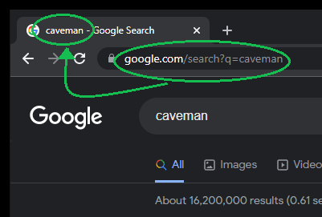

A simple test case
Load search URL
Verify title contains search term
Notes:
Our demo project has a single test case which is so simple that even a caveman can do it.
It loads a Google search in a browser, and verifies the search team is in the browser title.

Slide 22
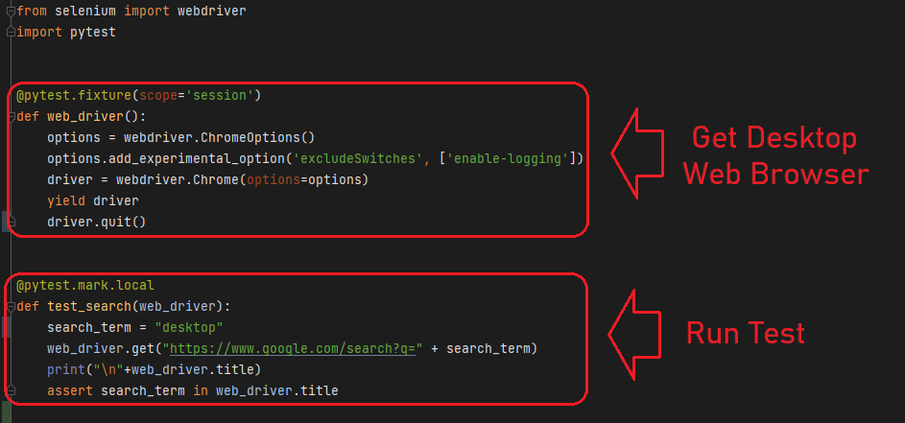
Level 1 code: Run on local machine
Notes:
This test is coded in Python.
We’ve followed the standard pattern where we get a selenium web driver as a resource,
and then we use that web browser to run the test.
For those of you who know web browser testing: You can see this code includes the important aspects of our pytest driver taking care of closing the browser when we are finished, and our test has an “assert” which is the business requirement we want to make sure works.

Slide 23
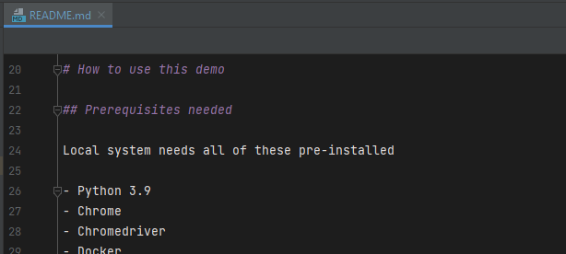


Auxiliary Files for Repeatability
Readme instructions
Library management
Convenience scripts
Notes:
Our tool also has some auxiliary files which are very important to helping our peers re-use the tool on their own laptops.
If we don’t include instructions on how to set up and use the tool, then we will be cursed to the purgatory of explaining to people the simple steps to get started
We include library management code, to make sure every new install can actually run
And we have some convenience scripts to wrap up the command line arguments needed every test run

Slide 24
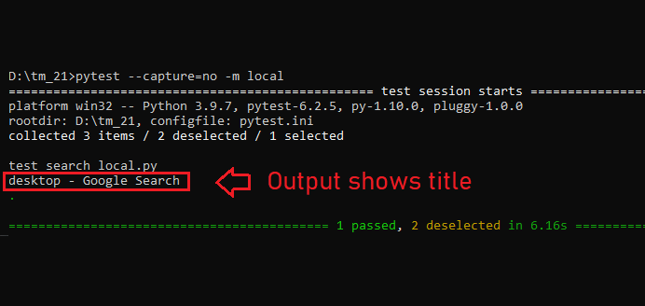
Level 1: Test Execution
Notes:
When we run this test, it passes!
Here I’ve highlighted the browser title bar to confirm our search team was what we expected

Slide 25
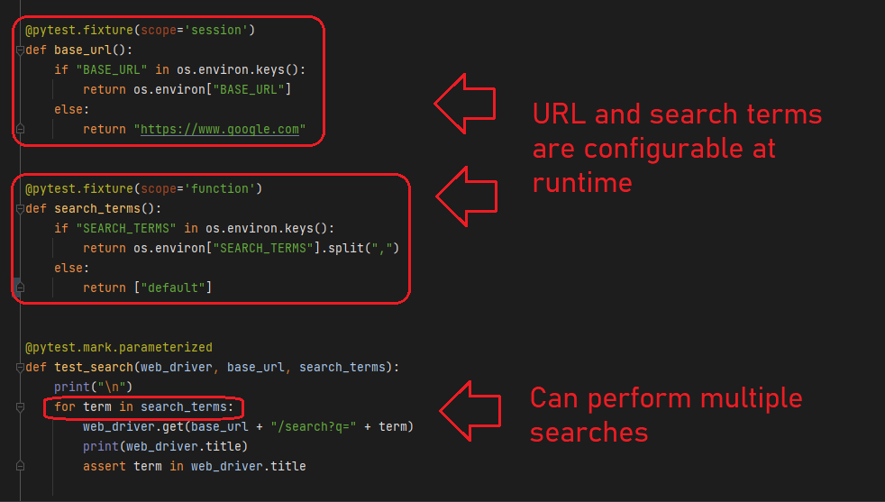
Level 2 code: Parameterized Tests
Notes:
The next level is to paramterize our tests.
In this case, we are going to let the URL we are searching, and the terms we are searching for, be loaded from our environment variables.
This means we can alter how the test works without having to edit the code.
This gives us a nice speed boost, because we don’t have to search through code looking for the place to alter our variables every time we want to adjust our test

Slide 26
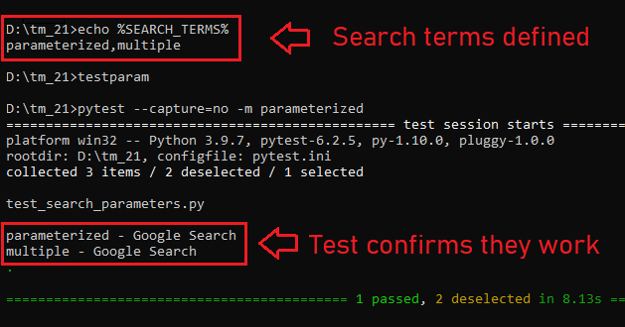
Level 2: Test Execution
Notes:
In our demo, we set our search terms in our environment and then run the test.
Now we see that the test run twice, and both times, it found the browser titles we were expecting.

Slide 27
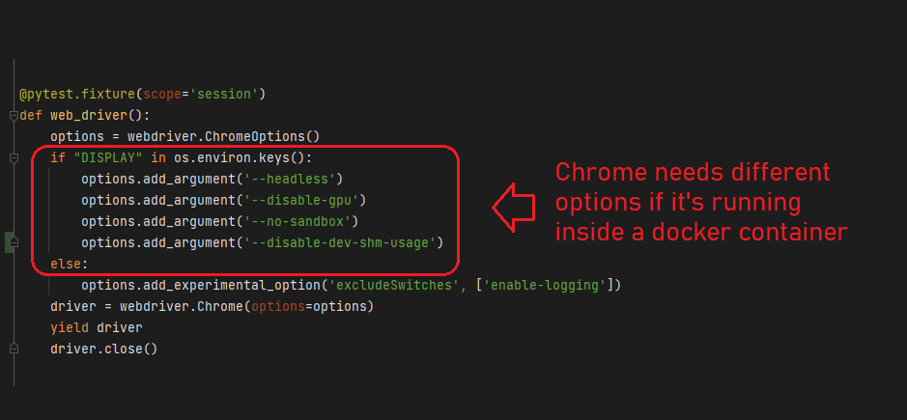
Level 3 code: Containerized Tests
Notes:
The next level of repeatability is to run our tests inside a standardized docker container.
Web browsers do not work as well inside docker as they do on our laptops. So first we must update our test code to check its environment to see if it’s running inside a docker container or not.
Inside the docker container, we have a special recipe that lets the web browser run in headless mode.
But when the test is run on our laptop, we get the same web browser as before

Slide 28
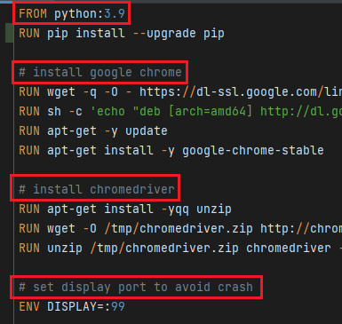
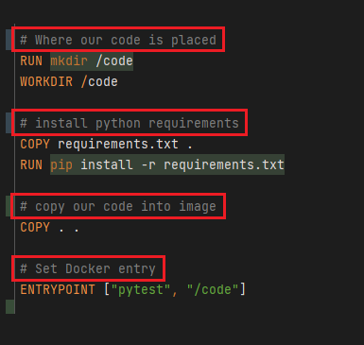
Level 3 Dockerfile: Image runs tests
Notes:
To create a docker image which has our tests, we have created a DockerFile.
For those who are unfamiliar with Docker: A DockerFile is a set of instructions telling Docker how to make an image. That image contains all of the software we need to run our tests.
In our simple dockerfile, we are including:
Python
Chrome web browser
Chrome web driver
Downloaded pythong libraries
Our code
Default instructions on how to start tests

Slide 29
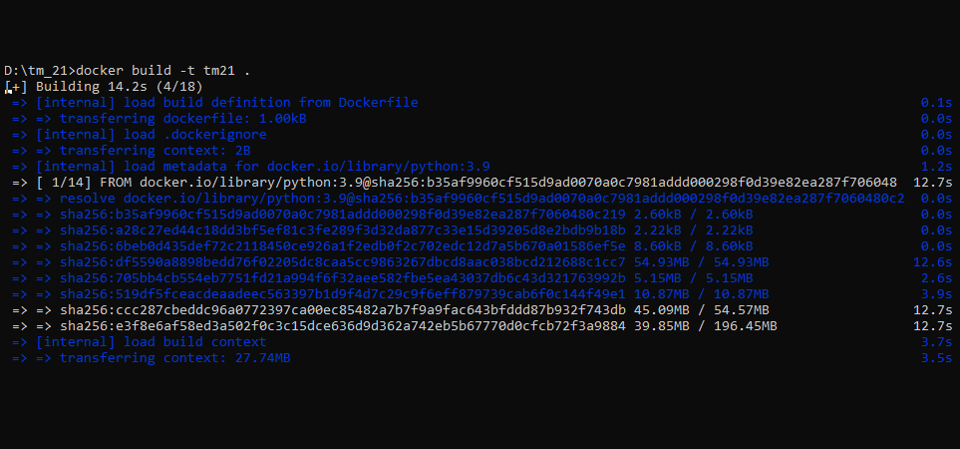
Level 3: Build container
Notes:
With our recipe complete, we will build our docker image.
This is a one-time process that downloads all the pieces and puts them together.

Slide 30
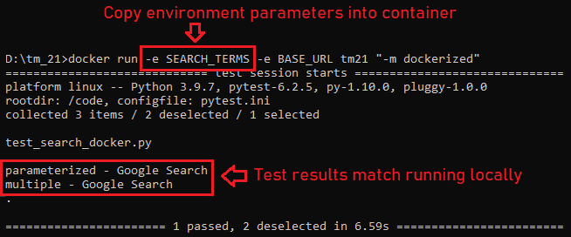
Level 3: Run tests in container
Notes:
Our built image can be run on any system with a single command, and with confidence that it will behave virtually identically every time. In this case, you see that the plaform has changed to Linux
When we run our image here, we also include the environment variable that has our search terms. This way we can control our docker container without having to modify how it was built.

Slide 31
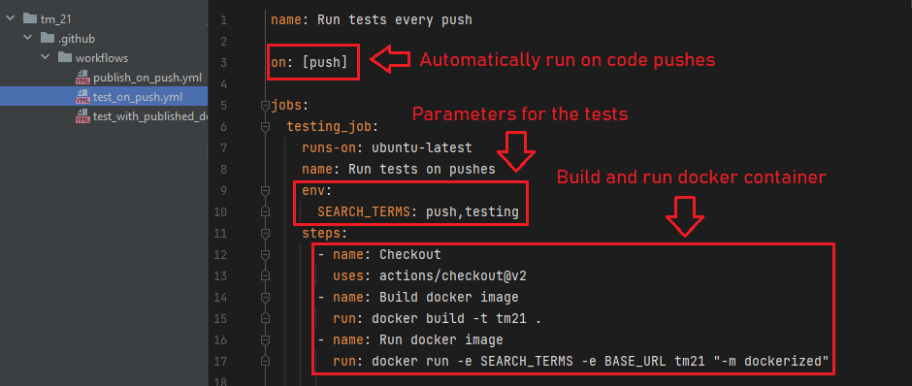
Level 4 action: Run automatically
Notes:
With a proven docker container, it is now easy to run our tests automatically in some kind of continuous integration pipeline.
For this demo, we will use Github actions.
This is convenient because our code is also hosted on Github, which makes the integration easy.
We will script this automated testing with YAML files inside our repository. Github knows to look for these files inside the github workflow directory.
in this file we are telling github to run this workflow every time new code is pushed to a branch on origin.
We also specify specify customized search terms.
The steps tell github actions to build and run our docker image with these custom parameters.

Slide 32
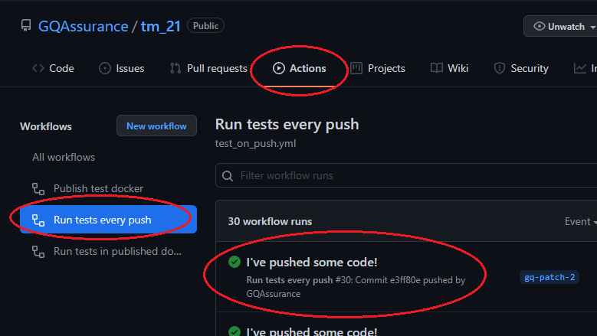
Level 4: Find Actions in GitHub
Notes:
The github website shows us the results of all of the actions it has run.
This workflow runs on every push.

Slide 33
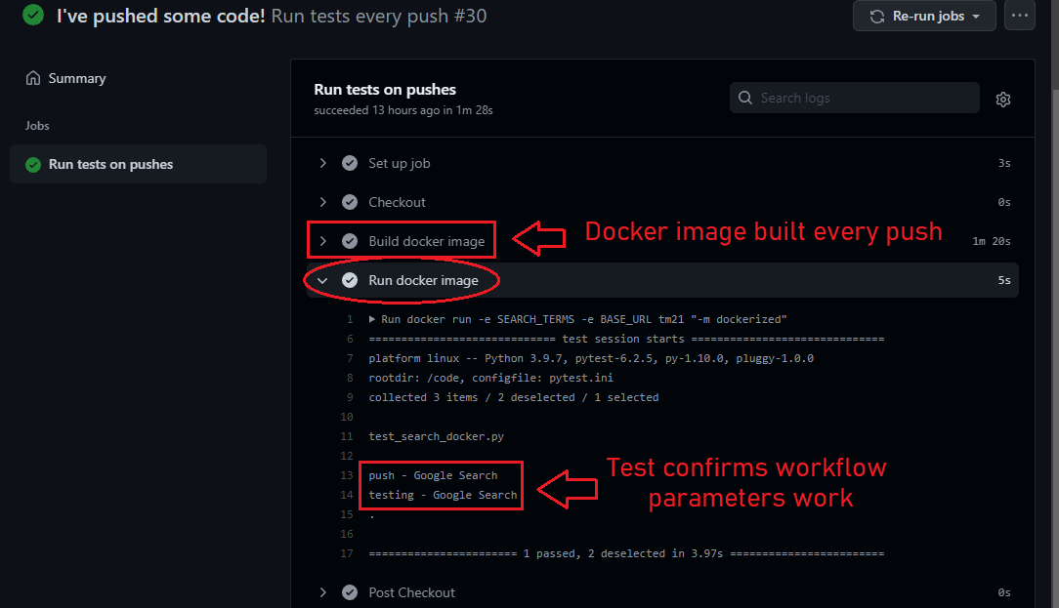
Level 4: Results of action from push
Notes:
Opening a specific run will show us the details of what happened.
This run shows us the unique search parameters we included in our workflow script.
This kind of workflow is a great way to ensure we do not push code to our repository which breaks any tests.

Slide 34
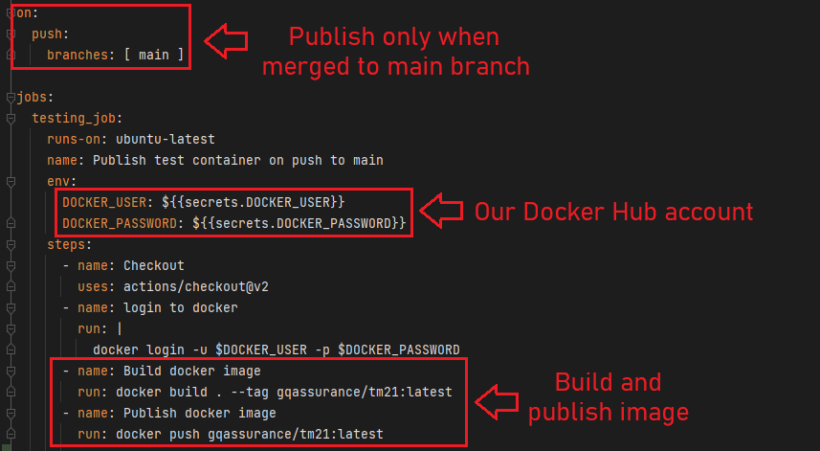
Level 5 action: Published container
Notes:
The last level in our repeatability model is to have our docker image published to a docker repository.
When the image is available on Docker Hub, anyone else can use it to run tests any time. They can either pull the image to their laptop for local runs, or they can include the image in their own CI pipelines.
In this demo, we will publish a new version of our Docker image every time we merge code to our “main” branch. This would match with a code branching strategy where our code has a new release being published to our production environment.
This workflow is like the previous one in that it builds a new docker image. But instead of running that image in a new container, it will instead connect to Docker Hub and push the image there.
We will tag this image as “latest” so people will always know how to find the latest version.

Slide 35
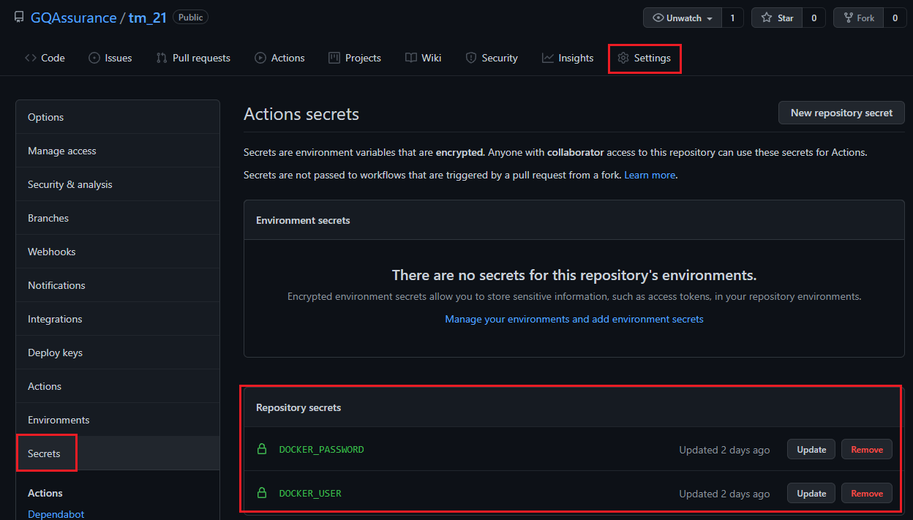
Level 5: Add Docker Hub credentials
Notes:
To allow Github to connect to Docker, we must provide our credentials. To maintain security, we will save these credentials in Githubs secrets registry. This ensures that even if someone were able to access our Github account, they will not be able to leverage that into accessing our Docker account.

Slide 36
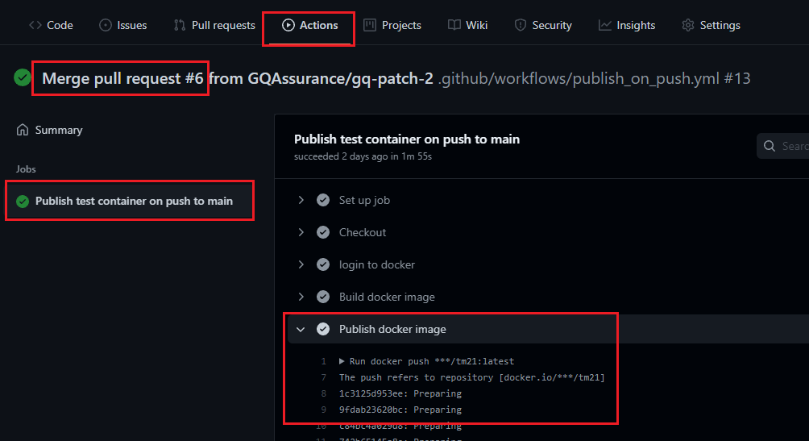
Level 5: Merge to Main branch
Notes:
After merging code into our main branch, this custom workflow is run.
The details of this workflow show us the steps of the docker image being built and pushed to Docker hub.

Slide 37
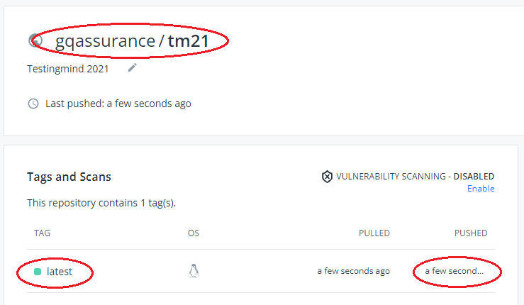
Level 5: Published image on Docker Hub
Notes:
After the workflow completes, the docker image is now visible on Docker hub.
This image will be overwritten every time a new “latest” image is pushed to the Docker Hub repository.
Now this public image is available for use by any system which has docker installed.

Slide 38
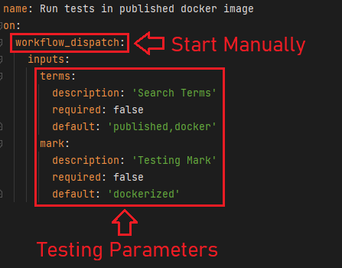
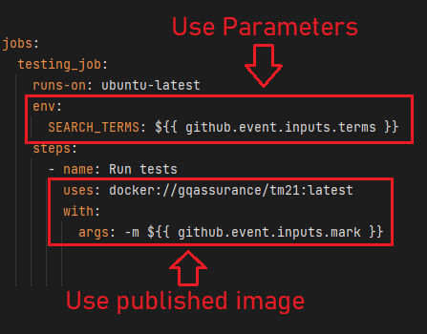
Level 5 action: Test Published Image
Notes:
To show how the published image can be used, we will create a third workflow in Github actions.
This workflow will run only when started manually on the website.
We will configure this workflow to accept some of the testing parameters our code accepts: in this case, we will specify our Search Terms and our Test Selection Mark. Each of these parameters also has a default.
The job itself will pull the docker image from Docker Hub, and pass in the parameterized inputs.

Slide 39
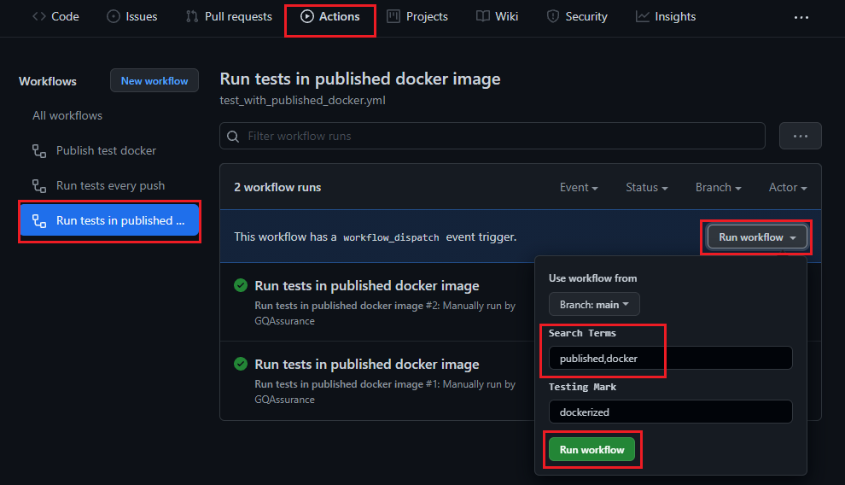
Level 5: Initiate Test Published Image
Notes:
To run this job manually, we find it in the Github actions menu.
We can change the parameters, or leave them as a default before starting the action.

Slide 40
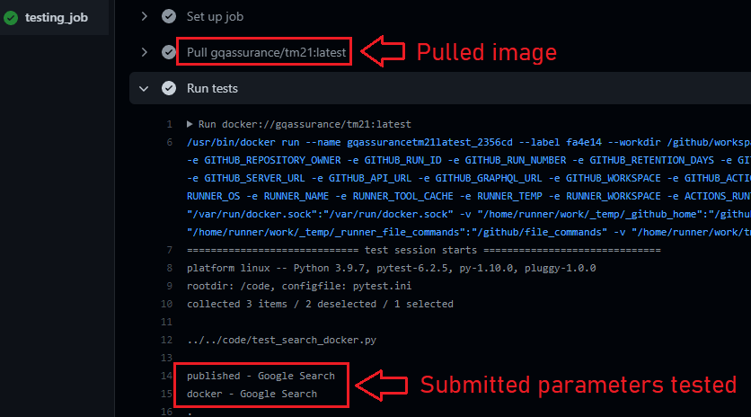
Level 5: Results of published image test
Notes:
The details of the workflow action show us that the image we published earlier is being pulled, and run with the parameters specified in our manually started job.
As you might guess: anyone can use this workflow in their own repository to run their tests on demand.
They can also use code pushes or code merges as triggers so the tests in their repositories will also run automatically.
Because these jobs are always taking the testing image from Docker hub, they will always be getting the latest version of the testing that we have created.
This means with a very reliable test suite, and a well designed process, our engineers can automatically use our tool to test their code as often as they want, and without anyone having to manually start a test run again.

Slide 41

So, what did we learn today?
Notes:
That’s the end of the quick demo.
If anyone wants to look at the code for themselves, the link to the github repository is at the end of this slide show.
So what do I hope you got from this presentation?

Slide 42
tldr;
Test automation is useful when reliable + repeatable
Improvements happen when planned & measured
Setting up CI pipelines is an easy start
A mature QA mindset focuses on enabling teammates
Notes:
The main things I hope I was able to show off:
Test Automation is only REALLY useful when it is reliable, and when it is repeatable
We get better improvements when we PLAN for our improvements, and when we MEASURE our improvements
Setting up continuous integration pipelines for our test automation tools is a very easy start, and it’s a great enabler for more improvements.
And most importantly:
I hope I’ve convinced at least some of you that a mature QA mindset is focused on the ultimate goal of enabling teammates. When we focus on that goal, it guides us to concentrate on improvements that keep our entire team moving fast.

Slide 43
Thank you for your time!
All the best wishes.
Demo code:
https://github.com/GQAssurance/tm_21
Notes:
The main things I hope I was able to show off:
Test Automation is only REALLY useful when it is reliable, and when it is repeatable
We get better improvements when we PLAN for our improvements, and when we MEASURE our improvements
Setting up continuous integration pipelines for our test automation tools is a very easy start, and it’s a great enabler for more improvements.
And most importantly:
I hope I’ve convinced at least some of you that a mature QA mindset is focused on the ultimate goal of enabling teammates. When we focus on that goal, it guides us to concentrate on improvements that keep our entire team moving fast.

